Slide 1

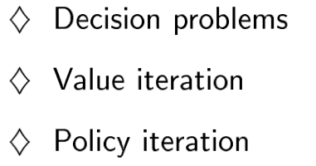
Probabilistic decision making
Slides adapted from: Brian C. Williams
(MIT 16.410), Manuela Veloso,
Reid Simmons, &
Tom Mitchell, CMU

Slide 2
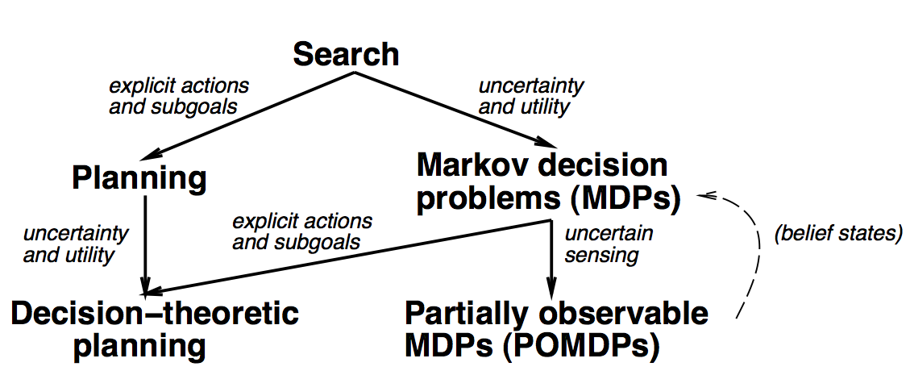
Sequential decision problems

Slide 3
How Might a Mouse Search a Maze for Cheese?
Cheese
State Space Search?
As a Constraint Satisfaction Problem?
Goal-directed Planning?
Linear Programming?
What is missing?

Slide 4
Ideas in this lecture
Problem is to accumulate rewards, rather than to achieve goal states.
Approach is to generate reactive policies for how to act in all situations, rather than plans for a single starting situation.
Policies fall out of value functions, which describe the greatest lifetime reward achievable at every state.
Value functions are iteratively approximated.

Slide 5
MDP Examples: TD-Gammon [Tesauro, 1995] Learning Through Reinforcement
Learns to play Backgammon
States:
Board configurations (10²⁰)
Actions:
Moves
Rewards:
+100 if win
- 100 if lose
0 for all other states
Trained by playing 1.5 million games against self.
Currently, roughly equal to best human player.

Slide 6
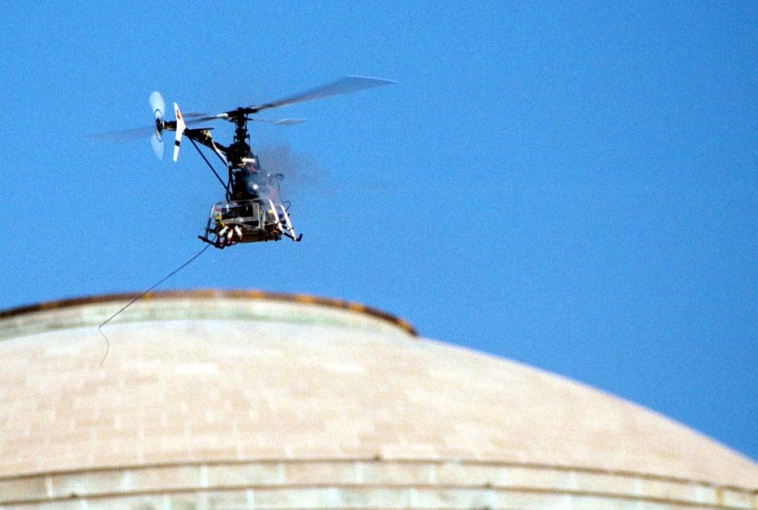
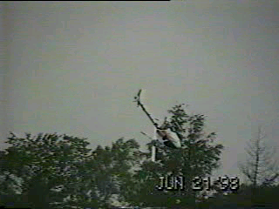
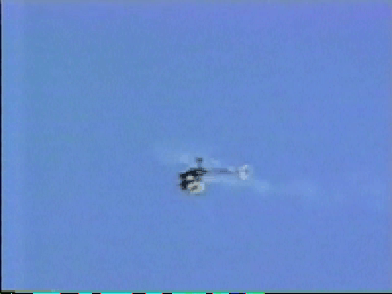
MDP Examples: Aerial Robotics [Feron et al.] Computing a Solution from a Continuous Model

Slide 7
Markov Decision Processes
Motivation
What are Markov Decision Processes (MDPs)?
Models
Lifetime Reward
Policies
Computing Policies From a Model
Summary

Slide 8
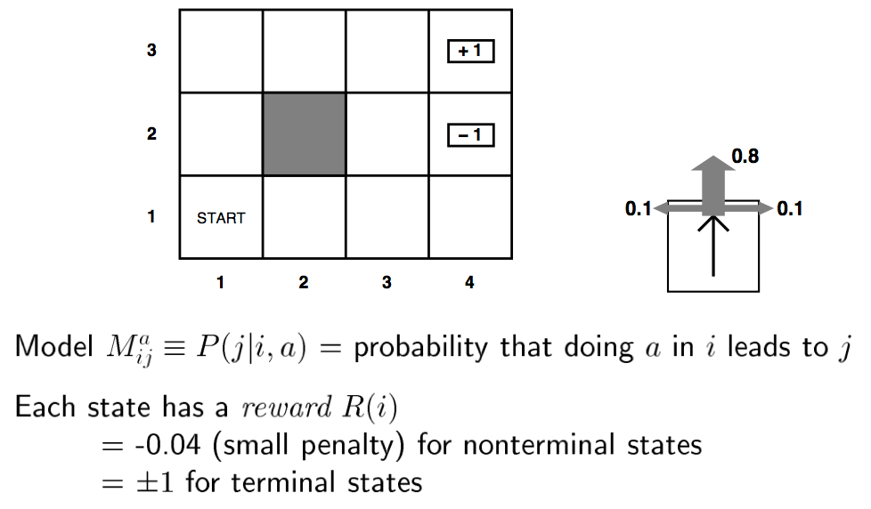
Example MDP

Slide 9
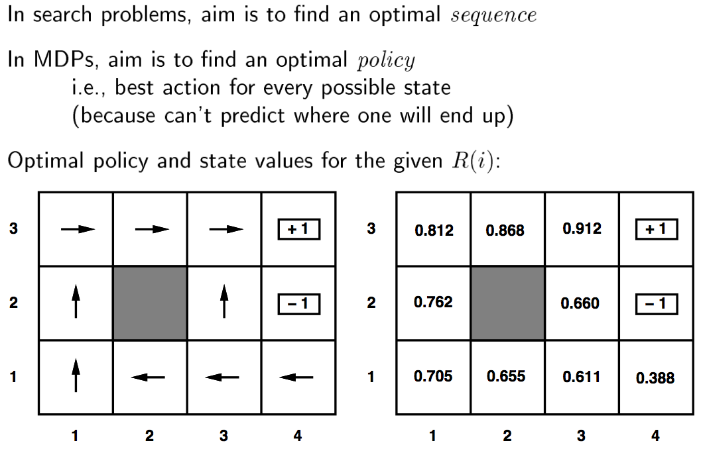
Example MDP

Slide 10
MDP Problem
Agent
State
Reward
Action
Environment
a₀
a₁
a₂
s₀
s₁
s₂
s₃
r₀
r₁
r₂
Given an environment model as a MDP create a policy for acting that maximizes lifetime reward

Slide 11
MDP Problem: Model
Agent
State
Reward
Action
Environment
a₀
a₁
a₂
s₀
s₁
s₂
s₃
r₀
r₁
r₂
Given an environment model as a MDP create a policy for acting that maximizes lifetime reward

Slide 12
Markov Decision Processes (MDPs)
Model:
Finite set of states, S
Finite set of actions, A
(Probabilistic) state transitions, δ(s,a)
Reward for each state and action, R(s,a)
Process:
Observe state s_{t} in S
Choose action a_{t} in A
Receive immediate reward r_{t}
State changes to s_{t+1}
Example:
a₀
a₁
a₂
s₀
s₁
s₂
s₃
s1
a1
r₀
r₁
r₂
10
Legal transitions shown
Reward on unlabeled transitions is 0.
G
10
10

Slide 13
MDP Environment Assumptions
Markov Assumption: Next state and reward is a function only of the current state and action:
s_{t+1} = δ(s_{t}, a_{t})
r_{t} = r(s_{t}, a_{t})
Uncertain and Unknown Environment:
δ and r may be nondeterministic and unknown

Slide 14
MDP Problem: Model
Agent
State
Reward
Action
Environment
a₀
a₁
a₂
s₀
s₁
s₂
s₃
r₀
r₁
r₂
Given an environment model as a MDP create a policy for acting that maximizes lifetime reward

Slide 15
MDP Problem: Lifetime Reward
Agent
State
Reward
Action
Environment
a₀
a₁
a₂
s₀
s₁
s₂
s₃
r₀
r₁
r₂
Given an environment model as a MDP create a policy for acting that maximizes lifetime reward

Slide 16
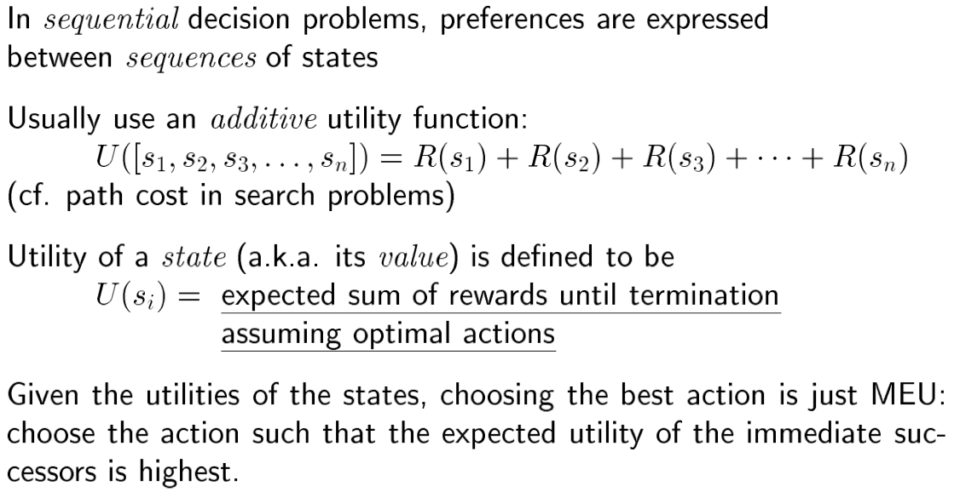
Utility (aka value)

Slide 17
Lifetime Reward
Finite horizon:
Rewards accumulate for a fixed period.
$100K + $100K + $100K = $300K
Infinite horizon:
Assume reward accumulates for ever
$100K + $100K + . . . = infinity
Discounting:
Future rewards not worth as much (a bird in hand …)
Introduce discount factor γ $100K + γ $100K + γ ² $100K. . . converges
Will make the math work

Slide 18
MDP Problem: Lifetime Reward
Agent
State
Reward
Action
Environment
a₀
a₁
a₂
s₀
s₁
s₂
s₃
r₀
r₁
r₂
Given an environment model as a MDP create a policy for acting that maximizes lifetime reward
V = r₀ + γ r₁ + γ ² r₂ . . .

Slide 19
MDP Problem: Policy
Agent
State
Reward
Action
Environment
a₀
a₁
a₂
s₀
s₁
s₂
s₃
r₀
r₁
r₂
Given an environment model as a MDP create a policy for acting that maximizes lifetime reward
V = r₀ + γ r₁ + γ ² r₂ . . .

Slide 20
Assume deterministic world
Policy π : S →A
Selects an action for each state.
Optimal policy π∗ : S →A
Selects action for each state that maximizes lifetime reward.
π
π∗
10
10
G
G
10
10
10
10
Note: with infinite horizon, policy is stationary and independent of start state

Slide 21
There are many policies, not all are necessarily optimal.
There may be several optimal policies.
10
10
G
G
10
10
10
10
10
A sequential decision problem for a fully
Observable stochastic environment with
Markovian transition model and additive
Rewards is called an MDP
G
10
10

Slide 22
Markov Decision Processes
Motivation
Markov Decision Processes
Computing Policies From a Model
Value Functions
Mapping Value Functions to Policies
Computing Value Functions through Value Iteration
An Alternative: Policy Iteration (appendix)
Summary

Slide 23
Value Function V^{π} for a Given Policy π
V^{π}(s_{t}) is the accumulated lifetime reward resulting from starting in state s_{t} and repeatedly executing policy π:
V^{π}(s_{t}) = r_{t} + γ r_{t+1} + γ ² r_{t+2} . . .
V^{π}(s_{t}) = ∑_{i} γ ^{i} r_{t+i} where r_{t}, r_{t+1} , r_{t+2} . . . are generated by following π, starting at s_{t} .
π
V^{π}
Assume γ = .9
9
10
9
10
G
10
10
10
10
0

Slide 24
An Optimal Policy π* Given Value Function V*
Idea: Given state s
Examine all possible actions a_{i} in state s.
Select action a_{i} with greatest lifetime reward.
Lifetime reward Q(s, a_{i}) is:
the immediate reward for taking action r(s,a) …
plus life time reward starting in target state V( δ(s, a) ) …
discounted by γ.
π*(s) = argmax_{a} [r(s,a) + γV∗( δ(s, a) )]
Must Know:
Value function
Environment model.
δ : S x A → S
r : S x A → ℜ
π
9
10
9
10
G
10
10
10
10
0

Slide 25
Example: Mapping Value Function to Policy
Agent selects optimal action from V:
π(s) = argmax_{a} [r(s,a) + γV(δ(s, a)]
Model + V:
γ = 0.9
90
100
100
0
G
81
90
100
100

Slide 26
Example: Mapping Value Function to Policy
Agent selects optimal action from V:
π(s) = argmax_{a} [r(s,a) + γV(δ(s, a)]
Model + V:
γ = 0.9
a
90
100
100
0
G
a: 0 + 0.9 x 100 = 90
b: 0 + 0.9 x 81 = 72.9
select a
b
81
90
100
100
π:
G

Slide 27
Example: Mapping Value Function to Policy
Agent selects optimal action from V:
π(s) = argmax_{a} [r(s,a) + γV(δ(s, a)]
Model + V:
γ = 0.9
90
100
100
0
G
a
a: 100 + 0.9 x 0 = 100
b: 0 + 0.9 x 90 = 81
select a
b
81
90
100
100
π:
G

Slide 28
Example: Mapping Value Function to Policy
Agent selects optimal action from V:
π(s) = argmax_{a} [r(s,a) + γV(δ(s, a)]
Model + V:
γ = 0.9
90
100
100
0
G
a: ?
b: ?
c: ?
select ?
a
b
81
90
100
100
c
π:
G

Slide 29
Markov Decision Processes
Motivation
Markov Decision Processes
Computing Policies From a Model
Value Functions
Mapping Value Functions to Policies
Computing Value Functions through Value Iteration
An Alternative: Policy Iteration
Summary

Slide 30
Value Function V∗ for an optimal policy π∗
Example
R_{B}
B
R_{A}
R_{B}
S_{A}
S_{B}
A
B
R_{A}
A
Optimal value function for a one step horizon:
V*₁(s) = max_{ai} [r(s,a_{i})]
V*₁(S_{A})
R_{A}
A
S_{A}
S_{A}
Max
B
R_{B}
. . .
S_{B}
S_{B}
V*₁(S_{B})

Slide 31
Value Function V∗ for an optimal policy π∗
Example
R_{B}
B
R_{A}
R_{B}
S_{A}
S_{B}
A
B
R_{A}
A
Optimal value function for a one step horizon:
V*₁(s) = max_{ai} [r(s,a_{i})]
Optimal value function for a two step horizon:
V*₂(s) = max_{ai} [r(s,a_{i}) + γV ₁∗(δ(s, a_{i}))]
V*₂(S_{A})
γ
V*₁(S_{A})
A
R_{A} +
A
Instance of the Dynamic Programming Principle:
Reuse shared sub-results
Exponential saving
S_{A}
S_{A}
S_{A}
Max
B
B
R_{B}
. . .
. . .
S_{B}
S_{B}
S_{B}
V*₂(S_{B})
+ γ
V*₁(S_{B})

Slide 32
Value Function V∗ for an optimal policy π∗
Example
R_{B}
B
R_{A}
R_{B}
S_{A}
S_{B}
A
B
R_{A}
A
Optimal value function for a one step horizon:
V*₁(s) = max_{ai} [r(s,a_{i})]
Optimal value function for a two step horizon:
V*₂(s) = max_{ai} [r(s,a_{i}) + γV ₁∗(δ(s, a_{i}))]
Optimal value function for an n step horizon:
V*_{n}(s) = max_{ai} [r(s,a_{i}) + γV _{n-1}∗(δ(s, a_{i}))]

Slide 33
Value Function V∗ for an optimal policy π∗
Example
R_{B}
B
R_{A}
R_{B}
S_{A}
S_{B}
A
B
R_{A}
A
Optimal value function for a one step horizon:
V*₁(s) = max_{ai} [r(s,a_{i})]
Optimal value function for a two step horizon:
V*₂(s) = max_{ai} [r(s,a_{i}) + γV ₁∗(δ(s, a_{i}))]
Optimal value function for an n step horizon:
V*_{n}(s) = max_{ai} [r(s,a_{i}) + γV _{n-1}∗(δ(s, a_{i}))]
Optimal value function for an infinite horizon:
V*(s) = max_{ai} [r(s,a_{i}) + γV∗(δ(s, a_{i}))]

Slide 34
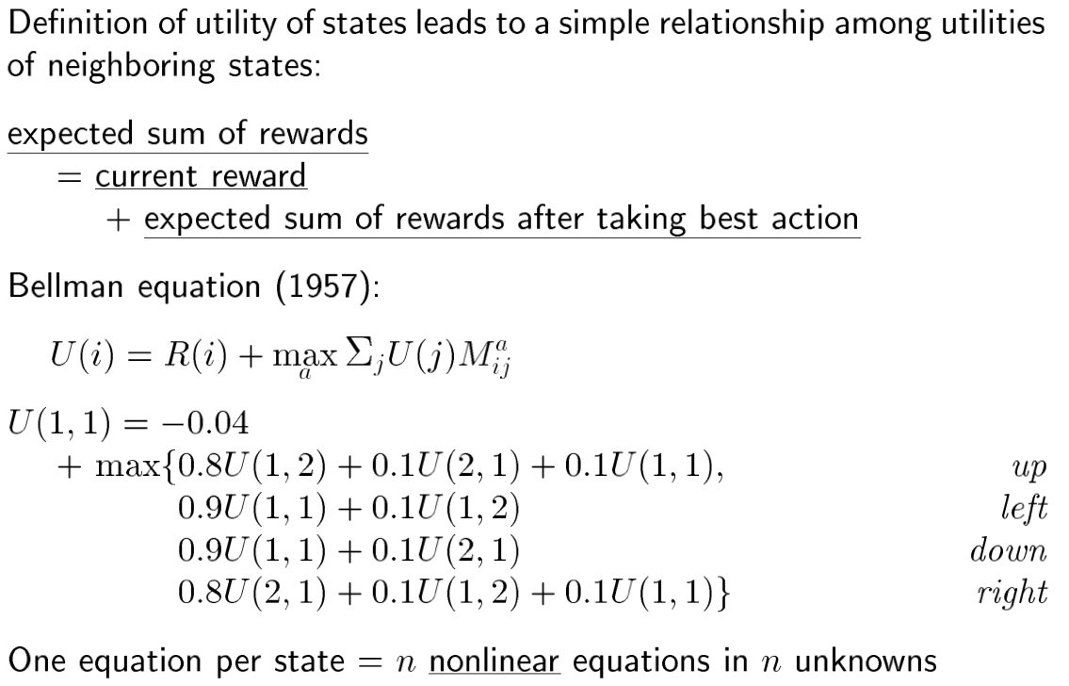
Bellman equation

Slide 35
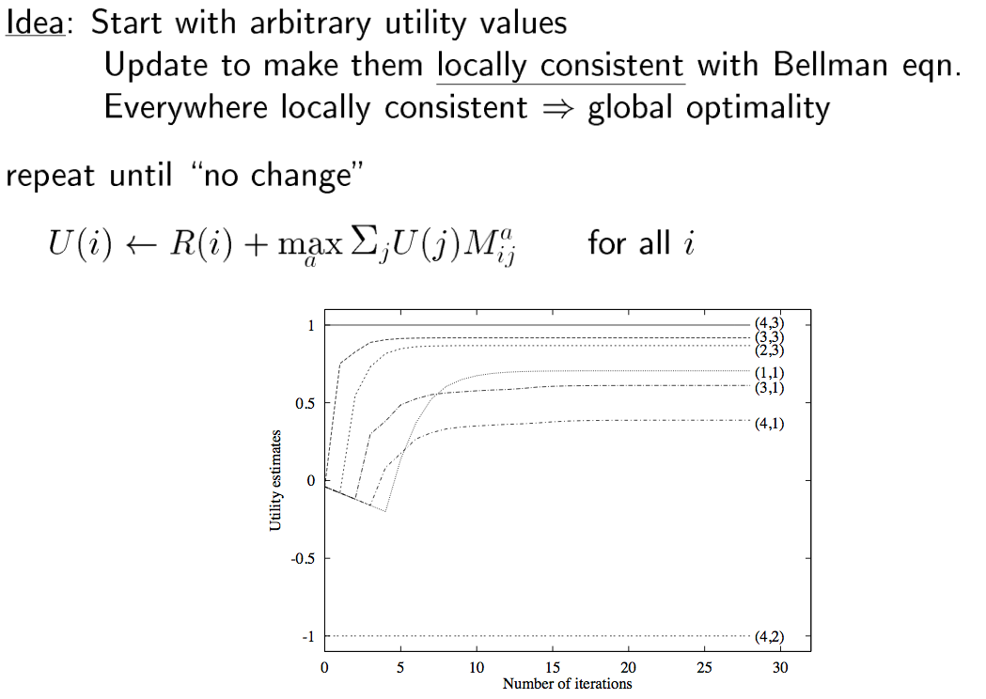
Value iteration algorithm

Slide 36
Solving MDPs by Value Iteration
Insight: Can calculate optimal values iteratively using Dynamic Programming.
Algorithm:
Iteratively calculate value using Bellman’s Equation:
V*_{t+1}(s) ← max_{a} [r(s,a) + γV∗ _{t}(δ(s, a))]
Terminate when values are “close enough”
|V*_{t+1}(s) - V∗ _{t} (s) | < ε
Agent selects optimal action by one step lookahead on V∗:
π*(s) = argmax_{a} [r(s,a) + γV∗(δ(s, a)]

Slide 37
Convergence of Value Iteration
If terminate when values are “close enough”
|V_{t+1}(s) - V _{t} (s) | < ε
Then:
Max_{s in S} |V_{t+1}(s) - V∗ (s) | < 2εγ/(1 - γ)
Converges in polynomial time.
Convergence guaranteed even if updates are performed infinitely often, but asynchronously and in any order.

Slide 38
Example of Value Iteration
V*_{t+1}(s) ← max_{a} [r(s,a) + γV∗ _{t}(δ(s, a))]
γ = 0.9
V∗ _{t}
V∗ _{t+1}
0
0
100
a
0
100
G
G
0
b
0
0
0
100
100
a: 0 + 0.9 x 0 = 0
b: 0 + 0.9 x 0 = 0
Max = 0

Slide 39
Example of Value Iteration
V*_{t+1}(s) ← max_{a} [r(s,a) + γV∗ _{t}(δ(s, a))]
γ = 0.9
V∗ _{t}
V∗ _{t+1}
0
0
100
0
100
G
G
c
a
0
100
b
0
0
0
100
100
a: 100 + 0.9 x 0 = 100
b: 0 + 0.9 x 0 = 0
c: 0 + 0.9 x 0 = 0
Max = 100

Slide 40
Example of Value Iteration
V*_{t+1}(s) ← max_{a} [r(s,a) + γV∗ _{t}(δ(s, a))]
γ = 0.9
V∗ _{t}
V∗ _{t+1}
0
0
100
0
100
G
G
a
0
100
0
0
0
0
100
100
a: 0 + 0.9 x 0 = 0
Max = 0

Slide 41
Example of Value Iteration
V*_{t+1}(s) ← max_{a} [r(s,a) + γV∗ _{t}(δ(s, a))]
γ = 0.9
V∗ _{t}
V∗ _{t+1}
0
0
100
0
100
G
G
0
100
0
0
0
0
100
100
0

Slide 42
Example of Value Iteration
V*_{t+1}(s) ← max_{a} [r(s,a) + γV∗ _{t}(δ(s, a))]
γ = 0.9
V∗ _{t}
V∗ _{t+1}
0
0
100
0
100
G
G
0
100
0
0
0
0
100
100
0
0

Slide 43
Example of Value Iteration
V*_{t+1}(s) ← max_{a} [r(s,a) + γV∗ _{t}(δ(s, a))]
γ = 0.9
V∗ _{t}
V∗ _{t+1}
0
0
100
0
100
G
G
0
100
0
0
0
0
100
100
0
0
100

Slide 44
Example of Value Iteration
V*_{t+1}(s) ← max_{a} [r(s,a) + γV∗ _{t}(δ(s, a))]
γ = 0.9
V∗ _{t}
V∗ _{t+1}
0
100
100
0
100
G
G
90
100
0
0
0
100
100
100
0
90
100

Slide 45
Example of Value Iteration
V*_{t+1}(s) ← max_{a} [r(s,a) + γV∗ _{t}(δ(s, a))]
γ = 0.9
V∗ _{t}
V∗ _{t+1}
90
100
100
0
100
G
G
90
100
0
0
90
100
100
100
81
90
100

Slide 46
Example of Value Iteration
V*_{t+1}(s) ← max_{a} [r(s,a) + γV∗ _{t}(δ(s, a))]
γ = 0.9
V∗ _{t}
V∗ _{t+1}
90
100
100
0
100
G
G
90
100
0
81
90
100
100
100
81
90
100

Slide 47
Markov Decision Processes
Motivation
Markov Decision Processes
Computing policies from a modelValue Functions
Mapping Value Functions to Policies
Computing Value Functions through Value Iteration
An Alternative: Policy Iteration (appendix)
Summary

Slide 48
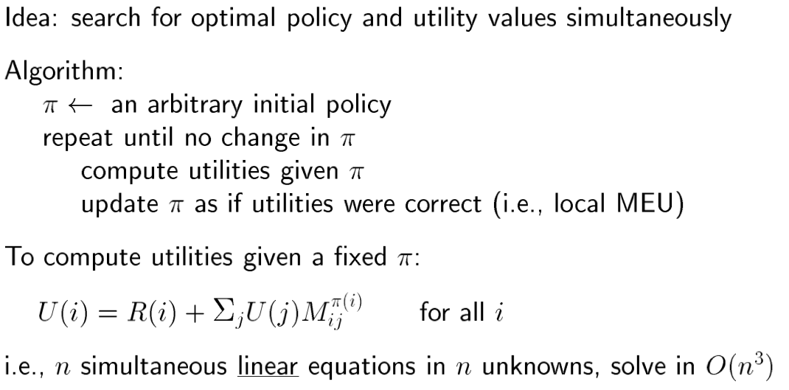
Policy iteration

Slide 49
Policy Iteration
Idea: Iteratively improve the policy
Policy Evaluation: Given a policy π_{i} calculate V_{i} = V^{πi}, the utility of each state if π_{i} were to be executed.
Policy Improvement: Calculate a new maximum expected utility policy π_{i+1} using one-step look ahead based on V_{i}.
π_{i} improves at every step, converging if π_{i} = π_{i+1}.
Computing V_{i} is simpler than for Value iteration (no max):
V*_{t+1}(s) ← r(s, π_{i}(s)) + γV∗ _{t}(δ(s, π_{i}(s)))]
Solve linear equations in O(N³)
Solve iteratively, similar to value iteration.

